Slide 1
Unit -8
Software Quality Assurance and Testing

Slide 2
Testing Principles
Principle 1
Testing is the process of excercising a software component using a selected set of test cases, with the intent of
Revealing defects
Evaluating quality
Principle 2
When the test objective is to detect defects, the a good test case is one that has a high probablity of revealing a yet undetected defect(s)
Principle 3
Test results should be inspected meticulously
Principle 4
A test case must contain the expected output or result

Slide 3
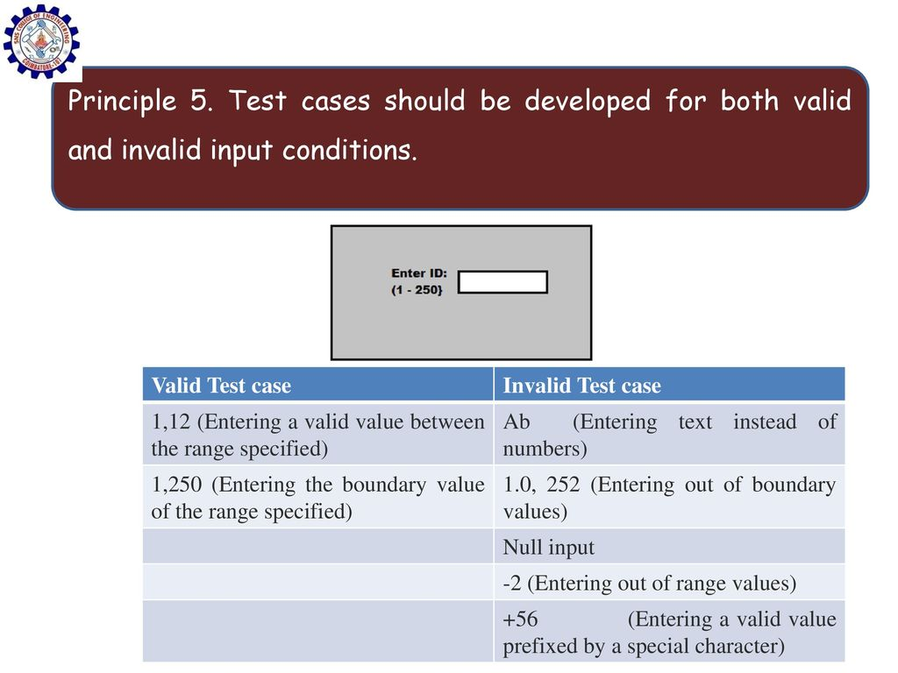

Slide 4
Principle 6
The probality of existence of additional defects in a software component is proportional to the number of defects already detected in that component
Principle 7
Testing should be carried out by a group that is independent of the development team
Principle 8
Test must be repeatable and reusable
Principle 9
Testing should be planned
Principle 10
Testing activities should be integrated into the software development life cycle
Principle 11
Testing is creative and Challenging task

Slide 5
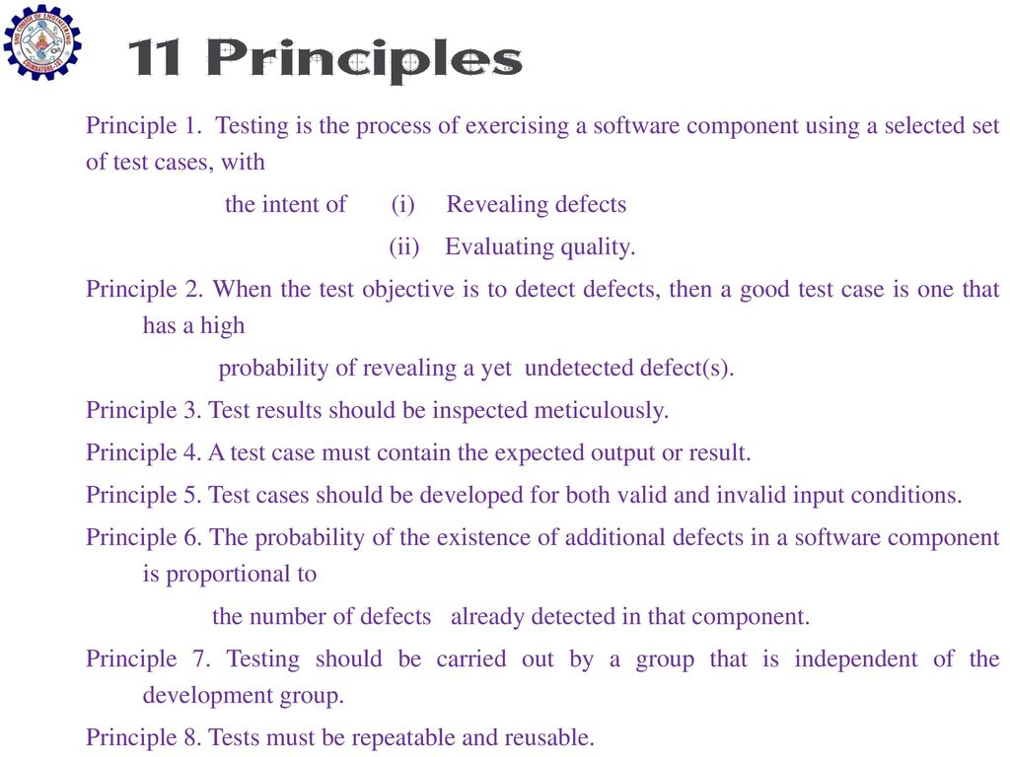

Slide 6
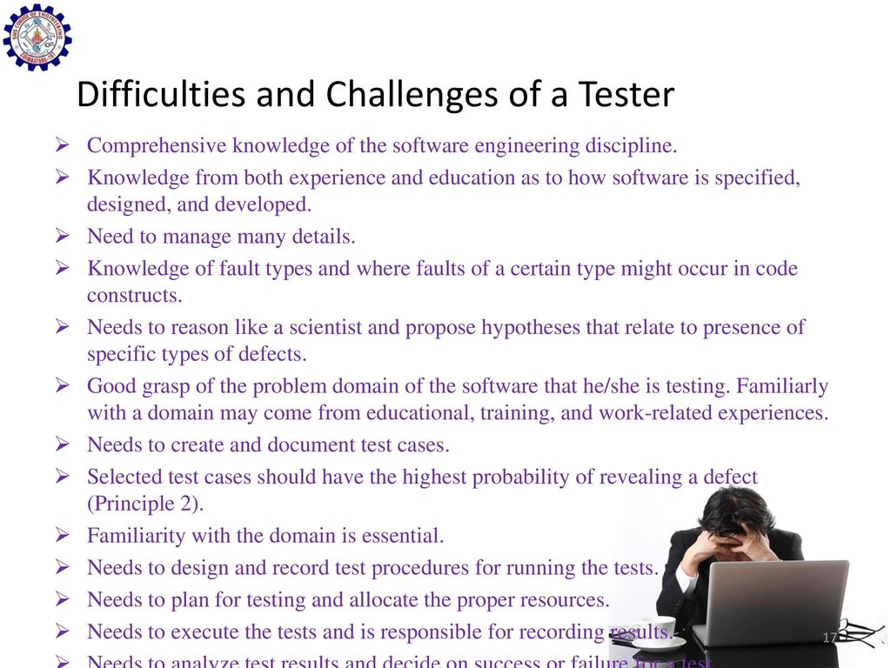

Slide 7
Objective of Testing
Finding defects which may get created by the programmer while developing the software.
Gaining confidence in and providing information about the level of quality.
To prevent defects.
To make sure that the end result meets the business and user requirements.

Slide 8
Test Plan
A Test Plan is a detailed document that describes the test strategy, objectives, schedule, estimation, deliverables, and resources required to perform testing for a software product.
Scope: Details the objectives of the particular project. Also, it details user scenarios to be used in tests. If necessary, the scope can specify what scenarios or issues the project will not cover.
Schedule: Details start dates and deadlines for testers to deliver results.
Strategy: A test plan documents the strategy that will be used to verify and ensure that a product or system meets its design specifications and other requirements.
A test strategy is an outline that describes the testing approach of the software development cycle. ... Test strategies describe how the product risks of the stakeholders are mitigated at the test-level, which types of testing are to be performed, and which entry and exit criteria apply.

Slide 9
Testing Approaches
Black-box testing. It is carried out to test functionality of the program.
White-box testing. It is conducted to test program and its implementation, in order to improve code efficiency or structure.
Unit Testing.
Integration Testing.
System Testing.
Acceptance Testing.
Regression Testing.
Before Testing.

Slide 10
Levels of testing
There are generally four recognized levels of testing:
unit/component testing,
integration testing,
system testing,
and acceptance testing.
Alpha testing
Beta testing
Tests are frequently grouped by where they are added in the software development process, or by the level of specificity of the test

Slide 11
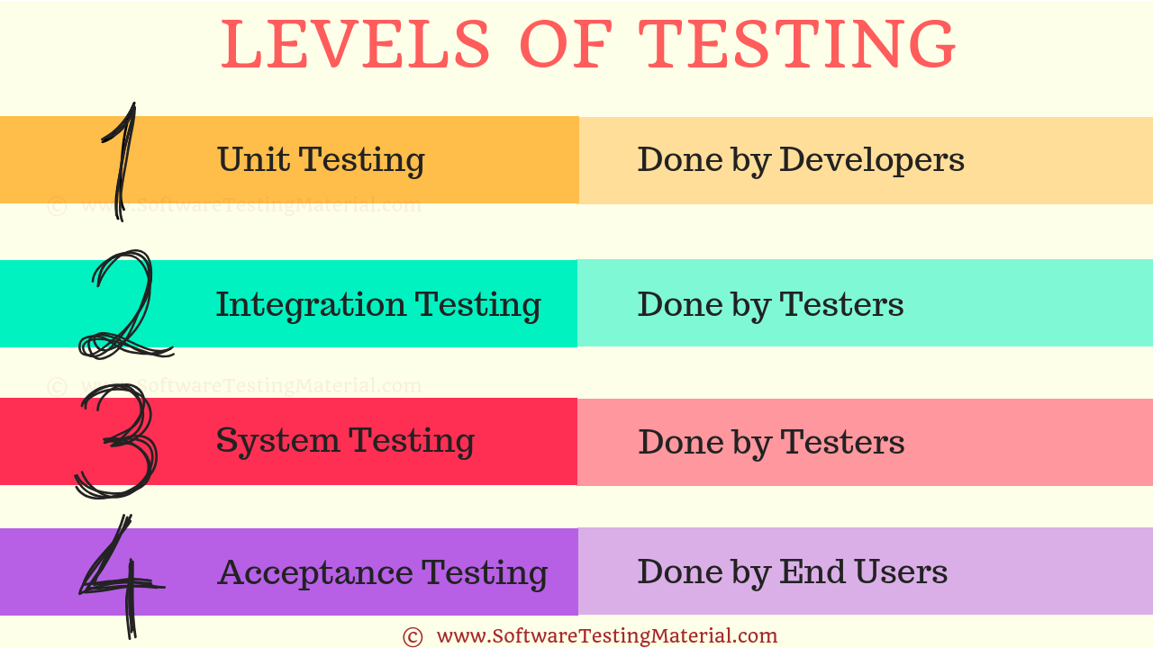

Slide 12
The structure of software test plan
The testing process: A description of the major phases of testing process.
Requirements traceability: Users are most interested in the system meeting its requirements and testing should be planned so that all requirements are individually tested
Tested items: The product. of the software process that are to be tested should be specified
Testing schedule: An overall schedule and resource allocation for this schedule is , obviously linked to the more general project development schedule
Test recording procedure: Simply run test not enough, the result of the test must be recorded systematically

Slide 13
Cont
H/W and S/W requirements: S/W tools required and estimated hardware utilisation
Constraints: Constraints affecting the testing process such as staff shortages

Slide 14
Program verification and validation
Verification and validation are not the same thing .
Verification is intend to show that a program meets its specification while validation is intended to show that the program does what the user requires.

Slide 15
Verification vs validation
Verification: "Are we building the product right”.
The software should conform to its specification.
Validation: "Are we building the right product”.
The software should do what the user really requires.

Slide 16
V & V confidence
Aim of V & V is to establish confidence that the system is ‘fit for purpose’.
Depends on system’s purpose, user expectations and marketing environment
Software purpose
The level of confidence depends on how critical the software is to an organisation.
User expectations
Users may have low expectations of certain kinds of software.
Marketing environment
Getting a product to market early may be more important than finding defects in the program.

